Slide 1
Amazon Rekognition
Automate your image and video analysis with machine learning
Péter Molnár, AWS Professional Services

Slide 2
Our mission at AWS
Put machine learning in the hands of every developer
Notes:
Our mission is to take our rich experience and expertise with machine learning across Amazon and put it in the hands of all organizations--every developer, data scientist, reseacher.
Said another way, we want to simplify machine learning. We want to make it easy for all developers to easily build intelligent applications

Slide 3
Why AWS for ML?
BROADEST AND DEEPEST SET OF AI AND ML SERVICES
ACCELERATE YOUR ADOPTION OF ML
BUILT ON THE MOST COMPREHENSIVE CLOUD PLATFORM
250 new features and services launched this last year for everyone from ML scientists to application developers
Amazon SageMaker creates efficiencies and lowers costs
Acceleration programs and trainings
The strongest set of compute, storage, security, database, and analytics capabilities to build upon
Notes:
To sum up, there are three core reasons why we think AWS is the right partner for your machine learning journey.
First, we provide the broadest and deepest set machine learning and AI services for your business:
AWS is unmatched in the breadth and depth of capability we offer to customers.
We launched over 250 new features and services in the last year
And our pace is only accelerating; developers will love waking up virtually every day with new capabilities at their finger-tips.
Second, we can accelerate the adoption of machine learning:
Amazon SageMaker makes it much easier for everyday developers and scientists to embrace machine learning.
Before SageMaker, doing ML was just too hard for most customers. By making ML easier, at low cost, customers can make better use of their data – which is both valuable and differentiating.
Models that previously took customers months and extensive specialized expertize can now be built in weeks or even days.
AWS has also invested in acceleration programs including the ML Solutions Lab and education and training programs like AWS DeepRacer and AWS ML Embark to help your organization more readily adopt ML.
Third, you get the confidence of building on AWS, the most comprehensive cloud platform optimized for machine learning:
That’s why today If you look at the amount of TensorFlow that runs in the cloud, 85 percent of the TensorFlow in the cloud runs on AWS.
We have a team that does nothing but work on optimizing TensorFlow performance on AWS. And they have done a lot of innovation.
Finally, you need the right highly secure, highly reliable, fully featured data store with the right access control, the right security, the broadest set of analytics, and really robust offerings -- at all three layers of the machine learning stack, which we believe that most companies with modern technology capabilities in the future will clearly operate at all three layers of that stack. That's what machine learning is and what's needed, and nobody has that set of capabilities collectively like AWS, which is why twice as many companies are using AWS for machine learning as anybody else.
Supporting data point:
Amazon EC2 Inf1 instances are built from the ground up to support machine learning inference applications. Inf1 instances feature up to 16 AWS Inferentia chips, high-performance machine learning inference chips designed and built by AWS. In addition, we’ve coupled the Inferentia chips with the latest custom 2nd generation Intel® Xeon® Scalable processors and up to 100 Gbps networking to enable high throughput inference. This powerful configuration enables Inf1 instances to deliver up to 3x higher throughput and up to 40% lower cost per inference than Amazon EC2 G4 instances, which were already the lowest cost instance for machine learning inference available in the cloud. Using Inf1 instances, customers can run large scale machine learning inference applications like image recognition, speech recognition, natural language processing, personalization, and fraud detection, at the lowest cost in the cloud.

Slide 4
Machine learning on AWS is happening in companies of every size and industry
Tens of thousands customers have chosen AWS for their ML workloads | More than twice as many customers using ML than any other cloud provider
Notes:
This approach resonates with our customers
More ML happens on AWS than anywhere else. From the largest enterprise through to the hottest startups, AWS has over twice the number of machine learning based public references than any other provider.
Companies are working with us to build solutions that are core to their business.

Slide 5





The AWS ML Stack Broadest and most complete set of machine learning capabilities
AI SERVICES
 | VISION | SPEECH | TEXT | SEARCH | CHATBOTS | PERSONALIZATION | FORECASTING | FRAUD | DEVELOPMENT | CONTACT CENTERS
Amazon Rekognition
Amazon Polly
Amazon Transcribe
+Medical
Amazon Comprehend
+Medical
Amazon Translate
Amazon Textract
Amazon Kendra
Amazon Lex
Amazon Personalize
Amazon Forecast
Amazon Fraud Detector
Amazon CodeGuru
Contact Lens
For Amazon Connect
ML SERVICES
Ground Truth | AWS Marketplace for ML |  |  |  |  |  |  |  |  |  | Neo | Augmented AI
 |  | Built-in algorithms | Notebooks | Experiments | Processing | Model training and tuning | Debugger | Autopilot | Model hosting | Model Monitor
SageMaker Studio IDE
Amazon SageMaker
ML FRAMEWORKS & INFRASTRUCTURE
Deep Learning AMIs & Containers | GPUs & CPUs | Elastic Inference | Inferentia | FPGA
DeepGraphLibrary
Notes:
We’re innovating on behalf of our customers to deliver the broadest and deepest set of machine learning capabilities for builders of all levels of expertise. At each layer of the stack, we’re investing in removing the undifferentiated heavy lifting so your teams can move faster.
Let’s take a walk through this the three layers.

Slide 6
The AWS ML Stack Broadest and most complete set of machine learning capabilities
AI SERVICES
 | VISION | SPEECH | TEXT | SEARCH | CHATBOTS | PERSONALIZATION | FORECASTING | FRAUD | DEVELOPMENT | CONTACT CENTERS
Amazon Rekognition
Amazon Polly
Amazon Transcribe
+Medical
Amazon Comprehend
+Medical
Amazon Translate
Amazon Textract
Amazon Kendra
Amazon Lex
Amazon Personalize
Amazon Forecast
Amazon Fraud Detector
Amazon CodeGuru
Contact Lens
For Amazon Connect
ML SERVICES
Ground Truth | AWS Marketplace for ML |  |  |  |  |  |  |  |  |  | Neo | Augmented AI
 |  | Built-in algorithms | Notebooks | Experiments | Processing | Model training and tuning | Debugger | Autopilot | Model hosting | Model Monitor
SageMaker Studio IDE
Amazon SageMaker
ML FRAMEWORKS & INFRASTRUCTURE
Deep Learning AMIs & Containers | GPUs & CPUs | Elastic Inference | Inferentia | FPGA
DeepGraphLibrary
Notes:
Now, at the top of the stack, we serve developers and companies who want to add solution-oriented intelligence to their applications through an API call rather than developing and training their own models in SageMaker. And we have a lot of services in this area to address your needs.
Vision (Rek Image and video) “tell me what’s in this image,” “which celebrities are in this image,” and, “is this image safe for work?”
Speech – (Polly, Transcribe) – If you want to turn text into speech we have Polly, and if you want to transcribe audio we have Transcribe
Text (translate, comprehend, textract) – If you want to translate text to different languages we have translate, and if you want to understand what’s being said in those translated corpuses of text you have Comprehend, if you want to extract text from documents using OCR++, you have Textract.
Then you have the things which Amazon is relatively famous for. Alexa and chatbots with Lex, personalization, and forecasting
Customers have asked us to continue to consider adding services around areas where we have a lot of experience and data from our consumer business…
Amazon Fraud Detector, a new fraud management service for detecting online identify and payment fraud in real-time. No machine learning experience required.
Amazon CodeGuru, a new machine learning service to automate code reviews and identify your most expensive line of code.
Contact Lens for Amazon Connect provides machine learning powered contact center analytics for Amazon Connect
Kendra, a new service which reinvents enterprise search with machine learning.
Let’s talk through some examples

Slide 7
Amazon Rekognition Overview

Slide 8
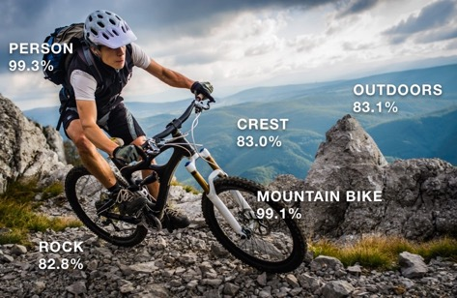

Amazon Rekognition Deep-Learning-Based Image and Video Analysis
Notes:
Amazon Rekognition is a service that applies machine learning to extract information from images and video

Slide 9
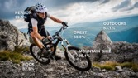



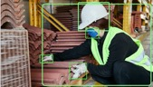

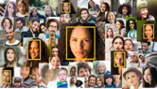
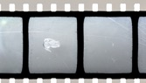
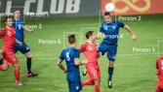
Amazon Rekognition Features
updated
updated
OBJECT, SCENE, AND ACTIVITY
CUSTOM LABELS
CONTENT MODERATION
TEXT
new
PPE DETECTION
FACE DETECTION AND ANALYSIS
FACE COMPARE & SEARCH
CELEBRITY RECOGNITION
new
VIDEO SEGMENTS
LIVE STREAM VIDEO
PATHING

Slide 10


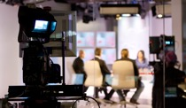

Common applications of Amazon Rekognition
Automated image and video analysis at scale
WORKPLACE SAFETY
PPE detection
Vehicle or person detection
Person of interest
IDENTITY VERIFICATION
Test taker fraud detection
Know your customer (KYC)
Service access verification
MEDIA ANALYSIS
Search & discovery tagging
Content operations
Inappropriate content
INDUSTRIAL & RETAIL
Parts classification
Inventory management
Damage detection

Slide 11


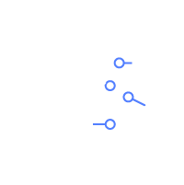
Why Amazon Rekognition
Build faster
Ready to integrate SDKs & APIs
High quality results
No ML Expertise required
Simplify operations
No ML models to build or manage
No data teams required
Get continuous improvements
Customize easily
Amazon Rekognition Custom Labels
Detect business-specific labels
Run trained models in your account
Innovate at the speed your business needs

Slide 12







































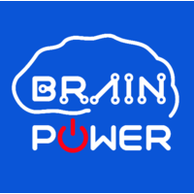
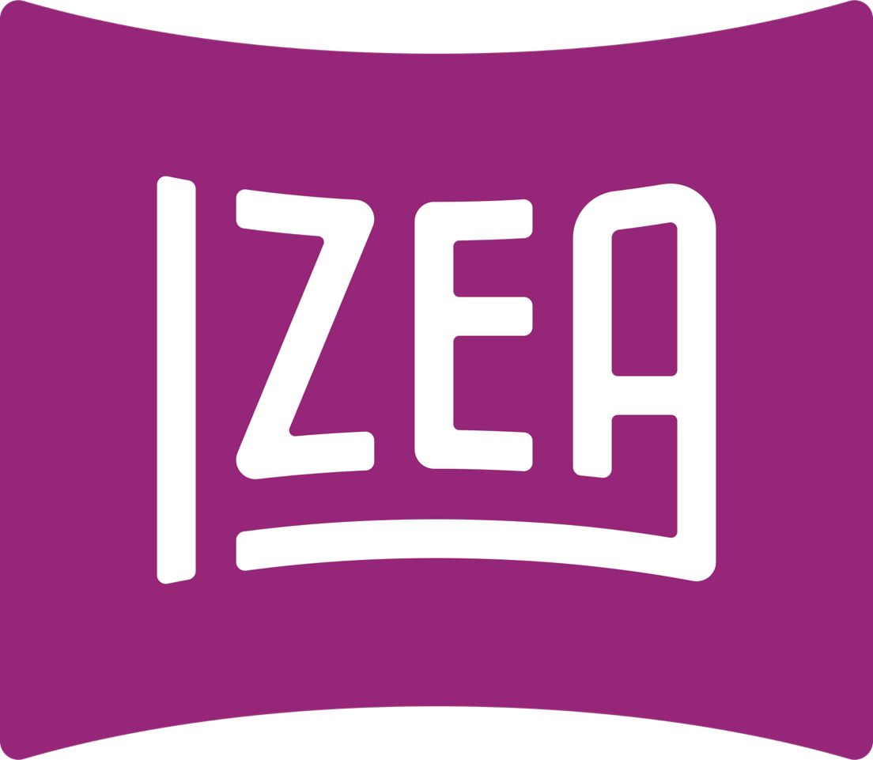







Amazon Rekognition Customers

Slide 13
Use cases and features

Slide 14



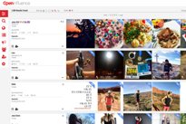
Media discovery
Live events
Media libraries
Social media
Influencer marketing

Slide 15


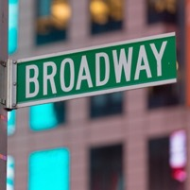
Tools for media discovery
Who
Celebrities
What
Labels and Activities
Where
Scenes and Text

Slide 16
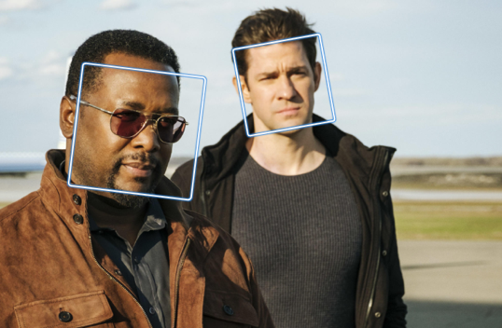
Celebrity detection
Amazon Rekognition quickly identifies well-known people in your video and images
Continually updated set of public celebrities who can be recognized
Jon Krasinski 99%
Wendell Pierce 97%

Slide 17



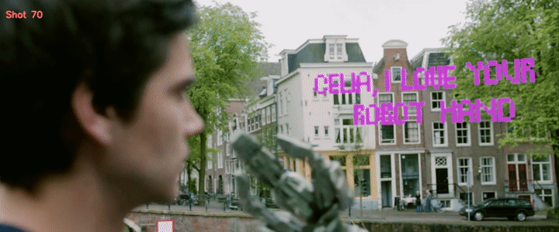
Video Segmentation
Video Segmentation – DETECT Black frames, color bars, end-credits, and shot changes
Black frames
End credits
Color bars
Shot Changes
Big Buck Bunny (2008) & Tears Of Steel (2013)
Blender Institute, shared under CC 3.0

Slide 18
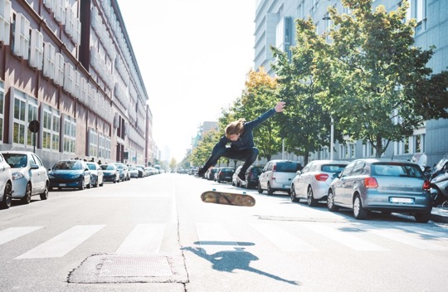
Object and scene detection
Architecture 79.8%
Person 98.3%
Sports 94.3%
Amazon Rekognition automatically labels objects, concepts, and scenes in your images and provides a confidence score
Transportation 98.8%
Automobile 98.8%
Downtown 88.9%
Skateboard 94.3%
City 88.9%
Parking 86.2%
Road 92.4%
Asphalt 85.4%

Slide 19
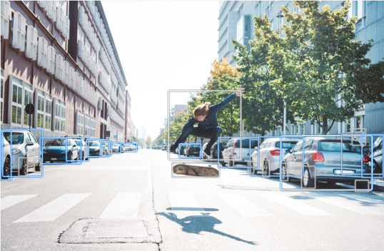
Object and scene detection
Bounding boxes specify the location of common objects such as dogs, people and cars
You can use bounding boxes to infer how many of each object (”3 cars”), and the relationship between objects (“person on a skateboard”)

Slide 20
Content Moderation
Top-level category | Second-level category
Explicit Nudity | Nudity Graphic Male Nudity Graphic Female Nudity Sexual Activity Illustrated Nudity Adult Toys
Suggestive | Female Swimwear Or Underwear Male Swimwear Or Underwear Partial Nudity Revealing Clothes
Violence | Graphic Violence Or Gore Physical Violence Weapon Violence Weapons Self Injury
Visually Disturbing | Emaciated Bodies Corpses Hanging
Top-level category | Second-level category
Rude Gestures | Middle Finger
Drugs | Drug Products Drug Use Pills Drug Paraphernalia
Tobacco | Tobacco Products Smoking
Alcohol | Alcoholic Beverages Drinking
Gambling | Gambling
Hate Symbols | Nazi Party White Supremacy Extremist
Amazon Rekognition does not flag content as “safe” or “unsafe”
Instead, you get granular output about the nature of the content. You can apply your own policies that define what is safe for your customers.
Notes:
With Rekognition content moderation, you can:
* define your own content standards with granular output
* reduce time between when content is uploaded and content is published
* augment your moderation workflow, not necessarily replace it outright

Slide 21
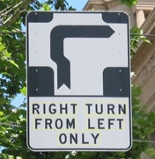
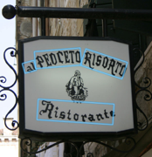
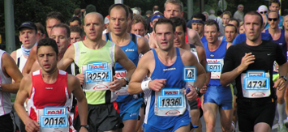
Text in the wild
Extract text content from real-world images in various layouts, fonts, and styles
New! Expanded support for text rotated -90 to +90 degrees from the horizontal axis

Slide 22
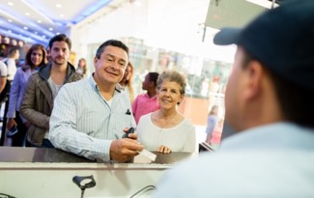

Face – Common Use Cases
Recognize Your Customer
Verify the identities of customers who opt-in
Customer Analysis
Analyze trends, not individuals

Slide 23





Recognize your customer Verify the identities of customers who opt-in
Similarity 93%
Similarity 0%

Slide 24
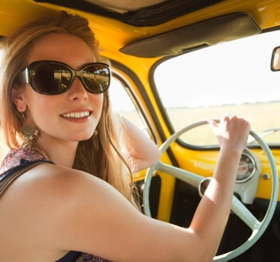
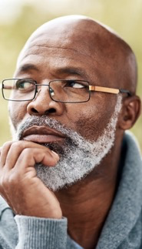
Face – customer analysis With trends, not individually
Sunglasses 99.5%
Glasses 89.6%
Amazon Rekognition object, scene, and activity detection can help you find customers’ social media posts about your product
Driving 95.4%
Accessories 99.5%

Slide 25
Face – customer analysis With trends, not individually
Female 99.9%
26–43 years old
Smiling 99.2%
Male 99.9%
Age 49–69 years old
Learn more about the customers who are using your products: Demographics, emotions, style, facial pose and landmarks
Not smiling 99.2%
Has a mustache 95.1%
Has a beard 98.2%

Slide 26
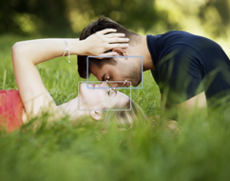
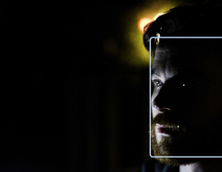
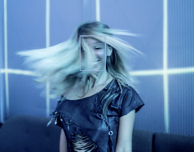
Face detection, analysis, and recognition
Pose
Lighting
Blur and occlusion

Slide 27
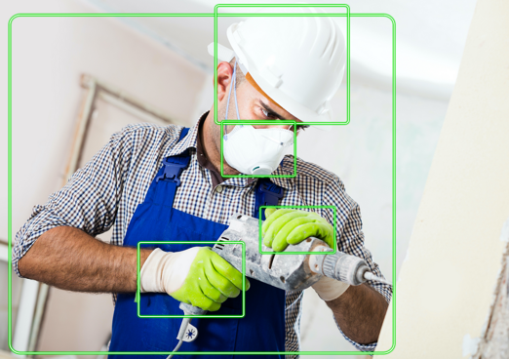
Personal Protective Equipment (PPE) Detection
Analyze images to detect if persons are wearing Face covers, head covers, hand covers
Head Cover 97%
Head Cover on head: true 96%
Face Cover 98.8%
Face cover on face: true 83.5%
Hand Cover 98.8%
Hand Cover on hand: true 94.8%

Slide 28
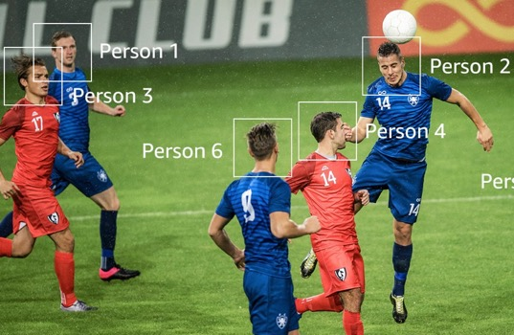
Activities and paths
When analyzing video, you can also identify specific activities such as “playing soccer
You can also capture the path of people or objects in the scene

Slide 29

Amazon Rekognition Custom Labels
What is it?
Automated Machine Learning (AutoML) vision service that enables…
customized image analysis
to easily detect objects and scenes you define as most relevant
to your domain at scale
Notes:
General to specific
Bring your own data
Domain experts can define labels

Slide 30
Amazon Rekognition Custom Labels
How it Works
Step 1:
Guided experience to create labeled images
Core Benefits
No ML expertise required
Low Code / No Code
Less training data
Tens to hundreds of images instead of tens of thousands
Fully managed by AWS
Step 2:
“Train” with a single click / API call. Evaluate with no coding and no ML experience
Step 3:
Use with fully managed, scalable, available APIs
Notes:
The images you train on and preparing your dataset is one of the most important parts of creating any custom model
You can bring already labeled data and through a console or APIs upload
OR you can bring images and have a guided experience to label those images.
No ML experience needed, once your images are in – you train. You can do it without code and no ML experience.
Ease of use of Rekognition

Slide 31
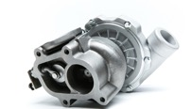



Examples of Custom Labels in Amazon Rekognition
Products
Icons, logos, and symbols
Comic and animation
Biological
Notes:
Making the service be responsive to our customer needs means enabling the service to understand things like:
Machine parts and being able to identify that this is a Turbocharger.
Recognizing logo, icons, and symbols that are important, the in example it would be the AWS architecture icons like EC2, S3, Amazon Rekognition, and Kinesis.
Comic or animated graphics like Arthur and Buster
Identifying bio diversity and its condition. In this case a healthy versus infected cucumber leaf.
Customers are using this for:
Custom Logos, Brands and Icons
Find animated characters
Identify specific objects, products or parts
Classify content at the image level identifying scenes etc.

Slide 32




How we can help
Solution Architects
ML Solutions Lab
Engage with a solution architect dedicated to your account
Brainstorm use cases and get support for solution implementation
Identify key areas where machine learning could help you with an AWS AI expert
Let AWS experts build POCs and custom solutions for your use case
Immersion day, workshops, training, and certification
AWS Partner Network
Let AWS certified partners help you with the POC and build integrations with your current systems to productionize
Conduct training workshops and hackathons for builders in your organization
Practical education on ML for new and experienced practitioners
Based on the same material used to train Amazon developers
Notes:
We recommend that you start a POC to test out the accuracy benefits that your business can see. AWS experts, Solution Architects and Partners can help you with a POC.

Slide 33
Q & A

Slide 34
Thank you!

Slide 35
Content Moderation

Slide 36

Moderating photo submissions
Coffee Meets Bagel uses Amazon Rekognition identify user-generated photos that need moderation. This reduces the need for human involvement by 97% and decreases the time required for photo approvals from hours to minutes.
Notes:
Coffee Meets Bagel is a dating and social networking website.
They needed to significantly lower costs of content moderation resources while improving accuracy results.
Amazon Rekognition makes it easy for them to detect and take action on user-generated photos that need moderation. The DetectModerationLabels API provides the intelligence to make automated decisions on content moderation.
This reduced the need for human involvement by 97% which helped lower moderation costs by 72%. It also helped us decrease the time required for photo approvals from hours to minutes while maintaining the same accuracy.
#AMER

Slide 37
Identity Verification

Slide 38

Real-time identity verification
Aella Credit uses Amazon Rekognition to analyze images to verify an individual’s identity in real-time without human intervention, allowing it to provide instant loans to eligible customers through its mobile app.
Notes:
Aella Credit provides instant loans to individuals with a verifiable source of income in emerging markets using biometric, employer, and mobile phone data.
Using Amazon Rekognition for identity verification on its mobile application has reduced verification errors significantly and given Aella the ability to scale.
It now detects and verifies an individual’s identity in real time without any human intervention, thereby allowing faster access to products.
#Financial #EMEA #Fraud Detection #Rekognition
More information: Case Study, Blog Post

Slide 39

Getting into concerts faster
K-STAR Group uses Amazon Rekognition to power Face Ticket, which helps concert attendees avoid long lines for tickets and entrance.
Notes:
K-STAR Group is an entertainment company that provides concert ticketing and payment services.
A recurring pain point at concerts is the long line that attendees wait in to provide proof of their purchased paper ticket and then have it validated at the entrance.
Using Amazon Rekognition they developed “Face Ticket” so concert attendees can quickly verify their purchase rather than waiting in line to get tickets or scan their paper ticket upon entrance.
Validating tickets is now a friction-less process--the concerts K-STAR Group supports no longer have lines and customer satisfaction has increased.
#KOREA

Slide 40

Personalizing the driving experience
Kia Motors uses Amazon Rekognition for advanced image and video analysis of an in-car camera that detects the driver. Then, the car automatically adjusts driver-assistance features like personalized mirror and seat positioning.
Notes:
Kia Motors, the oldest automobile manufacturer in South Korea, builds more than three million vehicles a year for customers in 180 countries.They use Amazon Rekognition for advanced image and video analysis of an in-car camera that detects the driver.
Then, the car automatically adjusts driver-assistance features like personalized mirror and seat positioning.
More info: https://partners.wsj.com/aws/kia-uses-ai-personalize-driver-experiences-improve-safety/
#Automotive #Driver Personalization #KOREA #Rekogntion

Slide 41
Public Safety

Slide 42

Fighting human trafficking
Marinus Analytics uses Amazon Rekognition to find human trafficking victims, then help law enforcement prosecute the traffickers.
Notes:
Marinus Analytics provides law enforcement with sophisticated tools to help foster victim-oriented policing in the age of the Internet.
Law enforcement knew that runaway children are among the most likely to be trafficked. Before using Amazon Rekognition, their only recourse was to manually sift through online data to try to find them; this was time-intensive or not possible.
Now with their Traffic Jam FaceSearch, powered by Amazon Rekognition, investigators are able to take effective action by searching through millions of records in seconds to find victims.
#AMER

Slide 43

Protecting children’s rights
Bachpan Bachao Andolan uses Amazon Rekognition to match online information against reports of abandoned and missing children.
Notes:
In partnership with Capgemini, Bachpan Bachao Andolan, an organization focused on children’s rights, launched an application to track and reunite missing children in India.
It’s estimated that 180 children go missing each day in India, and many are never found.
Bachpan Bachao Andolan’s application allows parents and others to post photographs of abandoned and missing children, and then makes use of Amazon Rekognition to match the children’s photographs against the reports and details to track them.
#IN

Slide 44
Marketing Analytics

Slide 45

Improving digital advertising
Amazon Rekognition helps New Engen analyze hundreds of thousands of images to locate the best subjects and materials to use in digital advertising.
Notes:
Amazon Rekognition has allowed New Engen's algorithms to analyze hundreds of thousands of images to locate subjects and materials that resonate most to its partners and their customers by delivering consistent image tagging and analysis efficiently and quickly.
More: https://aws.amazon.com/blogs/machine-learning/new-engen-improves-customer-acquisition-marketing-campaigns-using-amazon-rekognition/
#AMER

Slide 46

Targeted customer acquisition
VidMob uses Amazon Rekognition and Amazon Transcribe for metadata extraction and sentiment analysis, to help marketers understand which videos resonate with audiences. This allows marketers to promote targeted content to acquire new customers.
Notes:
VidMob is an award-winning technology platform that connects marketers of all sizes with a network of highly trained video creators, enabling businesses to dramatically improve their video marketing.
Uses Amazon Rekognition and Amazon Transcribe to help marketers get smarter about creative, and react, in real time, to data with freshly optimized media.
More: https://aws.amazon.com/blogs/machine-learning/vidmob-combines-computer-vision-and-language-ai-services-for-data-driven-creative-asset-production/
#AMER

Slide 47

Engaging fans with
video content
NASCAR uses Amazon SageMaker, Amazon Rekognition, and Amazon Transcribe to enhance metadata and captions for their new video series, saving thousands of hours of manual search time and better surfacing video clips to their 80 million fans.
Notes:
NASCAR will use the breadth and depth of AWS technologies to build cloud-based services and automate processes, including a new video series on NASCAR.com called This Moment in NASCAR History powered by AWS
NASCAR plans to use Amazon SageMaker to train deep learning models against 70 years of historical footage to enhance metadata and video analytics.
With Amazon Transcribe, an automatic speech recognition (ASR) service, NASCAR will be able to caption and time stamp every word of speech within archived videos so that NASCAR video producers can easily locate source footage via text searches
With Amazon Rekognition, they will automatically tag specific video frames with metadata, such as driver, car, race, lap, time, and sponsors so they can easily search those tags to surface the most iconic moments from past races.
By using AWS’s services, NASCAR expects to save thousands of hours of manual search time each year, and will be able to easily surface flashbacks like Dale Earnhardt Sr.’s 1987 “Pass in the Grass” or Denny Hamlin’s 2016 Daytona 500 photo finish, and quickly deliver these to fans via video clips on NASCAR.com and social media channels.
“Speed and efficiency are key in racing and business which is why we chose AWS—the cloud with unmatched performance, the most comprehensive set of services, and the fastest pace of innovation—to accelerate our migration to the cloud,” said Craig Neeb, Executive Vice President of Innovation and Development, NASCAR. “Leveraging AWS to power our new video series gives our highly engaged fans a historical look at our sport while providing a sneak peek at the initial results of this exciting collaboration.”
MORE INFO:
https://www.businesswire.com/news/home/20190604005654/en/NASCAR-Selects-AWS-Preferred-Cloud-Computing-Cloud
#AMER #M&E #SageMaker #Rekognition #Transcribe

Slide 48
Content Discovery

Slide 49
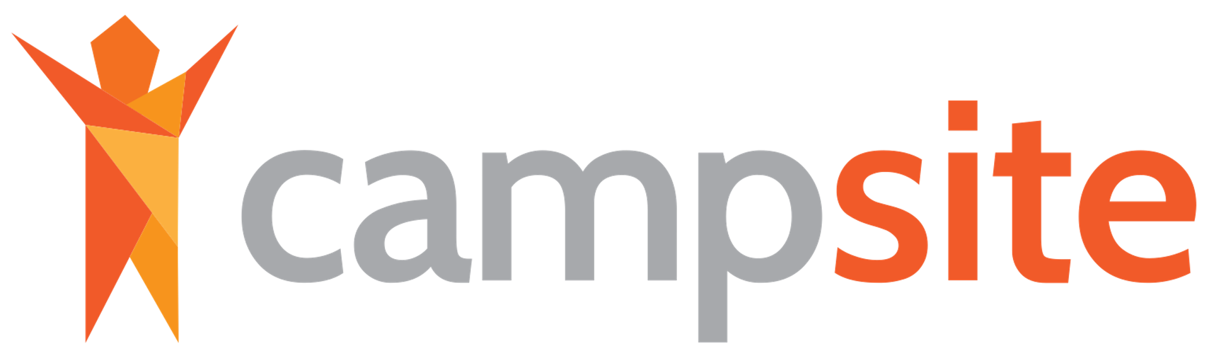
Sharing the good times
CampSite uses Amazon Rekognition to automatically tag photos of campers, so they can notify parents when a new photo of their camper is available.
Notes:
CampSite is a leading software platform for summer camps, serving camps across the world with a full suite of functionality including enrollment, staffing, media hosting, and more.
As part of their camper experience, CampSite’s customers were manually tagging photos of campers and sending to parents, a time-consuming and furstrating task.
Using Amazon Rekognition, CampSite automatically tags photos and notifies parents when a new photo of their camper has been uploaded.
This differentiates them in the market and provides parents with an exciting new service.
#AMER

Slide 50

Identifying family look-a-likes
FamilySearch uses Amazon Rekognition to analyze family photographs and show users which ancestors they most resemble.
Notes:
Speaker notes coming soon
#AMER

Slide 51

Making history fun
The White House Historical Association uses Amazon Rekognition to power the Presidential Lookalike tool, letting users upload a selfie to see which President or First Lady they most resemble.
Notes:
The White House Historical Association is a private, non-profit organization with a mission to enhance the public's understanding, appreciation, and enjoyment of the White House. They use Amazon Rekognition to power the Presidential Lookalike tool, letting users upload a selfie to see which President or First Lady they most resemble.
More: https://aws.amazon.com/solutions/case-studies/white-house-historical-association/
#AMER

Slide 52

Matching images with news
News UK uses Amazon Rekognition to create rich metadata for images in their content hub. This increases the speed and accuracy of identifying imagery for a given news story.
Notes:
News UK is a leading publisher whose properties include The Times, The Sunday Times, and The Sun.
The needed to increase the search granularity and speed of finding a suitable image for a News story by using a more efficient content categorization and content search.
They used Amazon Rekognition’s pre-trained machine learning models via API's (labels, text, faces, celebrities, content moderation) to automatically analyze the existing images in their content hub. This created new, rich metadata that contains detailed attributes about the discovered visual content.
They can now automatically categorize newly arriving image files, saving on cost and time.
#EMEA

Slide 53

Scaling video
indexing
C-SPAN uses Amazon Rekognition to automatically index video news footage for search. With Rekognition, C-SPAN reduced indexing time per video from 1 hour to 20 minutes and uploaded 97,000 images in under 2 hours.
Notes:
C-SPAN is a public service that provides gavel-to-gavel proceedings of the U.S. House of Representatives and the U.S. Senate, and to other forums where public policy is discussed, debated and decided––all without editing.
Using Rekognition, it more than doubled the amount of video that could be indexed annually, from 3,500 to 7,500 hours.
C-SPAN reduced the labor required to index an hour of video from 1 hour to 20 minutes. Uploaded 97,000 images in less than two hours.
Deployed in less than three weeks.
#AMER

Slide 54
Others

Slide 55

Helping users
find parking
Mapillary uses Amazon Rekognition to analyze the 360+ million images in their database and extract text from parking signs. That information enabled them to create a new parking solution.
Notes:
Mapillary is a collaborative street-level imagery platform that allows people and organizations to upload geo-tagged photos, which can then be used by customers to improve their mapping systems or applications.
In order to enrich their dynamic mapping content, Mapillary pair their computer vision algorithms that detect parking signs with Amazon Rekognition, which detects the text on those parking signs. This enables them to pair their computer vision algorithms that detect parking signs with Amazon Rekognition, which detects the text on those parking signs.
This is enabling them to create a new parking solution.
#EMEA

Slide 56

Increasing customer engagement
Using Amazon SageMaker, Tinder analyzes millions of match requests a minute, billions of swipes a day, across more than 190 countries to make the perfect match. With Amazon Rekognition, Tinder creates tags to highlight photos, resulting in 20% increase in engagement.
Notes:
For Tinder, highlighting photos via tags creates a richer more engaging experience. Compelling tags show a 20% lift in engagement in Top Picks, with the help of Amazon Rekognition.
“Behind every Tinder swipe is a system that manages millions of requests a minute, billions of swipes a day, across more than 190 countries. Amazon SageMaker simplifies machine learning, helping our development teams to build models for predictions that create new connections that otherwise might have never been possible.”
#AMER

Slide 57

Teaching social skills to those in need
Brain Power uses Amazon Rekognition and Kinesis Video Streams to build skills relevant to self-sufficiency in people with autism, ADHD, and other brain-related challenges.
Notes:
Brain Power is an organization that teaches social skills to people with autism and other brain-related challenges through computer vision and augmented reality.
Brain Power ran clinical trials and needed to analyze fidgeting and other body motions of clinical trial videos of children with autism and/or ADHD.
With Kinesis Video Streams and Amazon Rekognition, Brain Power captures movement and uses patterns of motion to measure the children’s improvement in symptoms after using their augmented-reality system.
#AMER

Slide 58

Preparing images at scale
The Mainichi Newspapers uses Amazon Rekognition to automatically analyze, trim, and resize photos for use in their publications.
Notes:
The Mainichi Newspapers is one of the major newspapers in Japan. It also publishes paperbacks, books and other magazines, including a weekly news magazine.
The Mainichi Newspapers provides a large number of news photographs on a daily basis, including our own web sites, smart phone applications, and corporate sales. When delivering news photos to a variety of users, they need to first process them by enlargement, reduction, and clipping. These tasks require manual work to judge the composition and content of the photograph one by one, and the price was enormous both in terms of time and cost.
Using Amazon Rekognition, they implemented process automation to recognize and analyze human faces, enabling automated analysis of human face’s position, size, number and composition in the blink of an eye. It also enabled trimming and resizing without losing content of original photos.
With manual processes, it takes about 10 work days to be delivered. With Rekognition, photos can be delivered the same day.
#JAPN

